Slide 1
Electric vehicles standards, charging infrastructure, & impact on grid integration
- A technological review
H.S. Das a*, M.M. Rahman b*, S. Li a*, C.W. Tan c*
a Department of Electrical and Computer Engineering, The University of Alabama, Tuscaloosa, 35401, USA
b Department of Electrical Engineering, King Saud University, Riyadh, 12372, Saudi Arabia
c Faculty of Electrical Engineering, Universiti Teknologi Malaysia, Johor, 81310, Malaysia

Slide 2
Agenda
Introduction
Current Status - EV technology and grid infrastructure
EV Charging and grid integration Standards
EV charging infrastructure
EV Power Grid Integration
Future development trend of EVGI
Challenges in EV technologies and EVGI system
Conclusion & Proposal

Slide 3
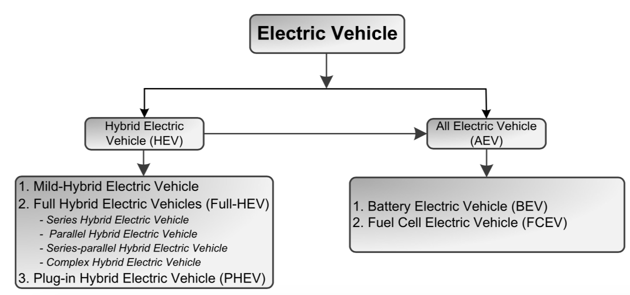
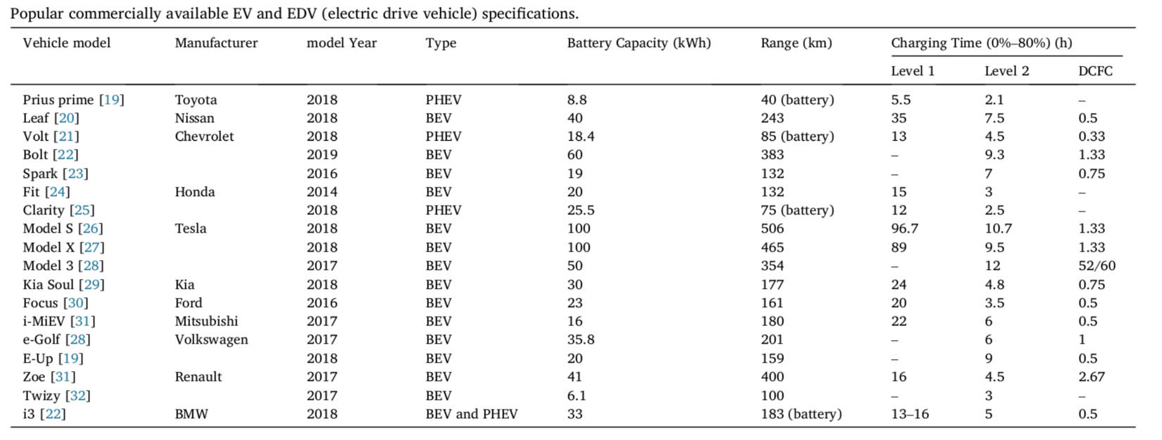
Introduction : Electric Vehicle - EVs
Notes:
EVs can be divided into two main categories: hybrid electric vehicles (HEVs) and all-electric vehicles (AEVs) [17,18]. AEVs are equipped with only electric motors powered by electrical sources. AEVs can be further classified into Battery EVs (BEVs) and Fuel Cell EVs (FCEVs). A FCEV does not require an external charging system. However, a BEV relies only on external power from the grid for charging the storage unit. A plug-in hybrid EV (PHEV) is one type of HEVs with an option to recharge its battery from the grid. In this study, BEVs and PHEVs are together named as EVs.
Some technical specifications of commercially available EVs released by different manufacturers. The approximate charging time required to charge the vehicle from 0% to at least 80% in different charging standards are also shown in the table. Here, Level 1 corresponds to the charging voltage of 110–120 V, Level 2 is of 220–240 V and Level 3 or DC fast charging (DCFC) is of 200–800 V. It can be noticed that the range of an EV based on battery drive is about 100 km for most of the vehicles, and several models have the battery-drive ranges around 200 km–400 km.

Slide 4
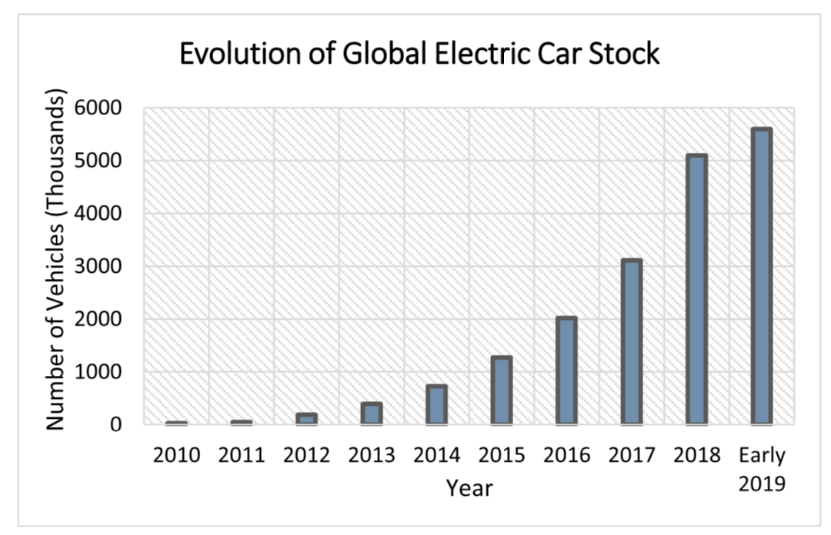
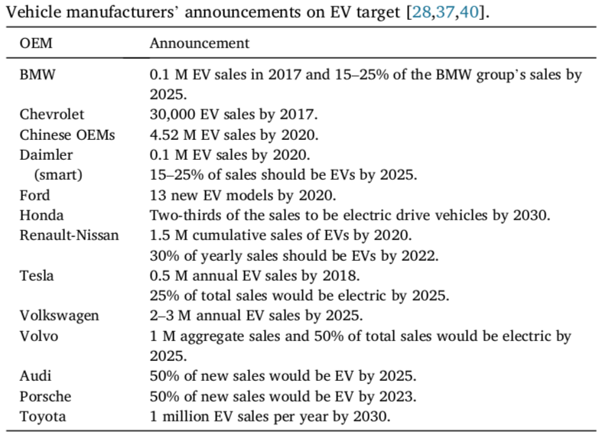
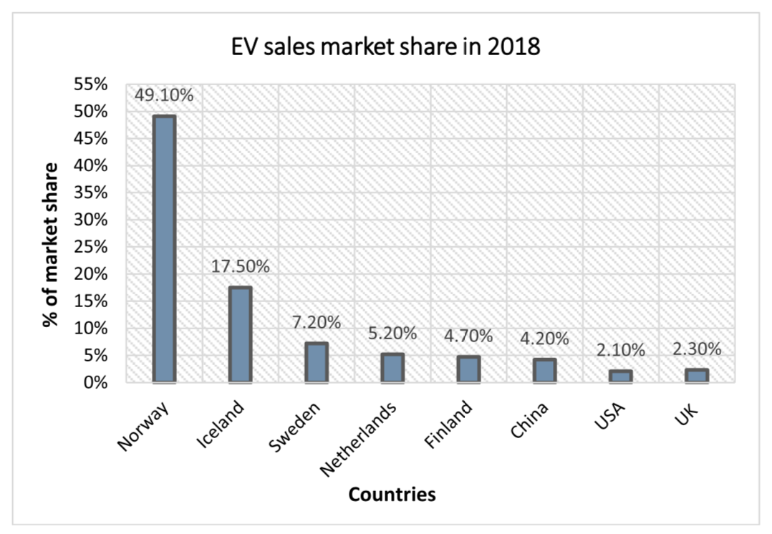
Current status : EV technology
Recent reports show that the number of EVs have reached 3 million thresholds in the year 2017 whereas ten years before there were only hundreds of them on the road
Despite numerous advantages of EVs, only a handful of countries are participating in the global EV market. The primary reasons are the high cost and production number being limited.
Manufacturers are setting production targets. The Energy Outlook predicts that about 100 million EVs will be on the road worldwide by 2035 and according to International Energy Agency (IEA), the target of EV production is set to 548 million by 2040
.
Notes:
The modern EV technologies are comparatively new, and EVs are now gaining popularity due to several advantages, such as zero emission, no dependency on fossil fuel, efficient, relatively silent, and so on. Research on EVs has been focused on increasing vehicle range and efficiency, reducing the price as well as developing methods for an efficient charging system.
The list of countries leading the sales of EVs in 2018
Despite numerous advantages of EVs, only a handful of countries are participating in the global EV market. The primary reasons are the high cost and production number being limited.

Slide 5
Current status : EV charging and grid integration
Growing EV market results in a large number of EV charging stations, which are the medium for EV grid integration (EVGI)
The significant portion of EV charging is residential charging with slow charging ports, however, the future charging stations are planned to be built up at commercial places to facilitate them as EV refueling stations which will have all types of charging ports
Several commercial charging stations have already been established which have fast charging points and can charge an EV within an hour. For example, until 2018, Tesla has established total 1431 supercharger stations in all over the world from which 694 are in North America, 442 in Europe and 294 in Asia Pacific region.
The Canadian Automobile Association (CAA) has declared that with the cooperation of another charging infrastructure company Charge Hub, 7906 charging stations have been established in major cities of Canada. This number includes both fast and slow charging stations.

Slide 6
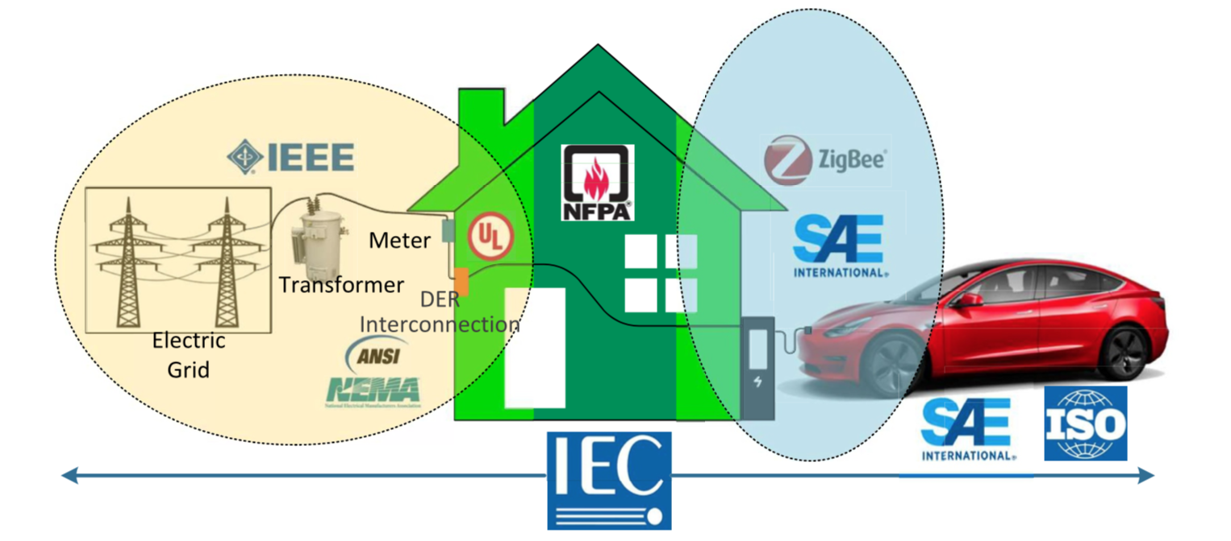
Standards: EV charging and grid integration
Notes:
Among EV charging component standardization organizations, International Organization for Standardization (ISO) works on standardizing EVs as a whole , and the others work on component level specification.
The grid integration standards handle EV charging/discharging with the grid. There are two major players in grid interconnection standards, namely The Institute of Electrical and Electronics Engineers (IEEE), and Underwriters’ Laboratories (UL).
The safety standards for EV charging and grid integration are defined by most of the above mentioned organizations. However, organizations like The National Fire Protection Association (NFPA) and National Electric Code (NEC) work on safety measures mainly.

Slide 7
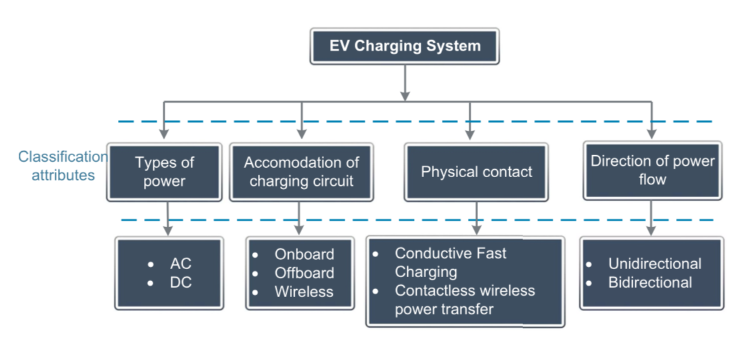
EV charging infrastructure
EV charging infrastructure comprises of
Power infrastructure
Control infrastructure
Communication infrastructure
Power infrastructure provides an electric circuit or system for power flow between EVs and the grid. It can be classified according to the types of power used, accommodation of the charging circuit, physical contact requirements, and power flow direction
Control and communication infrastructure is the fundamental element for real-time monitoring and control of EV charging. Although EV charging represents an additional load demand in the power system, it can be scheduled to reduce the peak demand and charging cost through proper management and coordination of EV charging stations connected with the grid based on the control architecture and communication infrastructure involved in the EV charging
Notes:
AC charging has different voltage and frequency levels based on the power system of a concerned country. In terms of the voltage levels, AC charging can be divided into Levels 1, 2 and 3 charging, where level 3 has the highest charging voltage. The Levels 1 and 2 charging facilities can be installed in a private location while setting up of Level 3 charging facilities, involving separate wiring and transformer, requires permission from utility providers and are usually built in public charging stations. At the same voltage level, DC charging is faster and usually has a high charging power capacity. The latest DC fast charging (DCFC) technology can fully charge an EV within as low as 20 min
The charging circuit can be accommodated either in a car (on-board charging) or in a charging station (off-board charging). Onboard charger allows the EV owner to recharge their car batteries wherever power supply is available [74]. It is compact in size, lightweight, and low cost but possesses low power delivery capacity. which causes a longer charging time and affects the driver satisfaction. Contrarily, off-board EV charger has less concerns in weight and size [76–79] and facilitates multiple charging modes including slow and fast charging schemes in the same infrastructure. However, setting up off-board chargers can be expensive due to the multiple charging schemes within a charging station. Apart from on and off-board chargers, wireless charging can be considered as a third type of charging system, in which the energizing coils are set up outside the vehicle, but the receiving coil and converter are mounted inside the vehicle
A conductive charging system maintains physical contact between the power supply and the battery on-board whereas a contactless charging system transfers power without any physical contact.
Conductive charging can be subdivided into slow charging (Levels 1 and 2) and fast charging (Level 3 or DCFC). The latest charging stations use DCFC to charge the vehicles, and it is the key to increase the popularity of EVs. Contactless charging system typically uses WPT technology to charge the battery. WPT system can operate in every voltage levels (Levels 1, 2 and 3) and has the power rating up to 20 KW. The recorded efficiency is up to 90%.
The unidirectional charger is easy to control because of less complexity. It minimizes battery degradation and has fewer interconnection issues compared to bidirectional types. However, unidirectional chargers
This bidirectional of charger can operate in either charging or discharging mode, which en ables EVs to provide various ancillary services to the grid. But, the frequent cycling of the discharging power back to the grid can degrade the EV battery lifetime. In addition, the metering and grid stability is sues, which involves selling and buying electricity from utilities, makes the process complex.

Slide 8
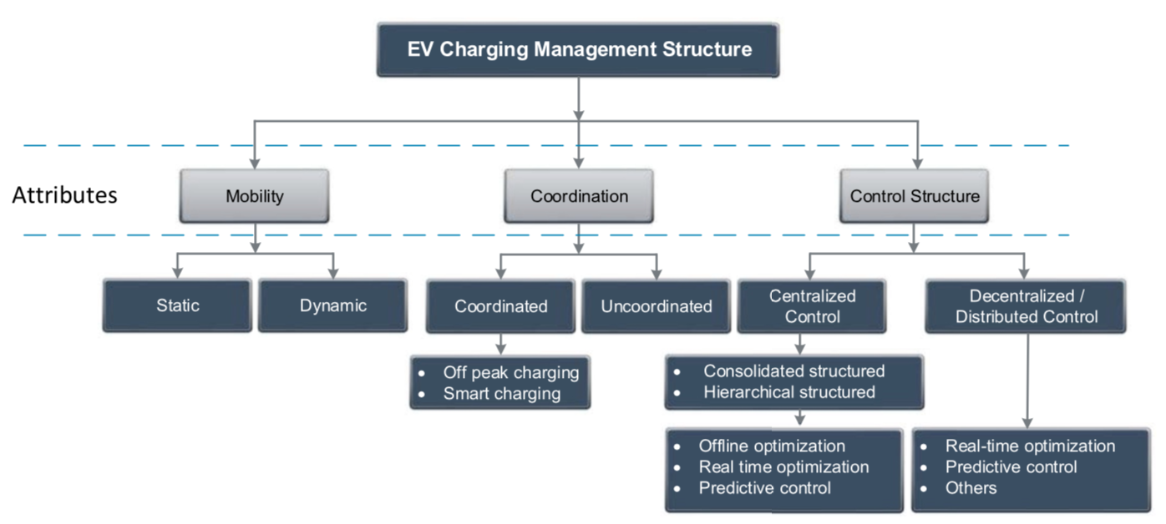
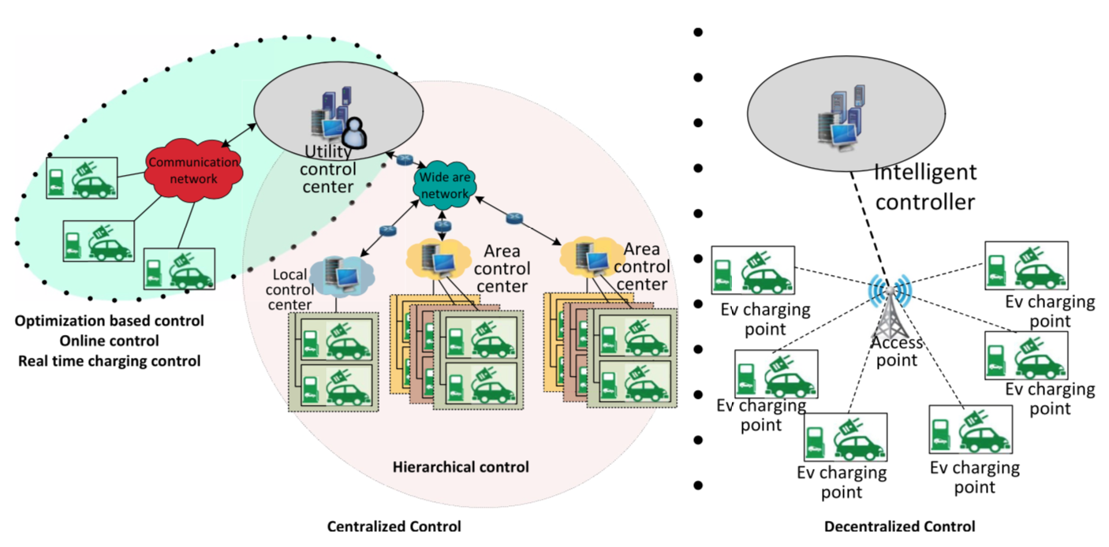
Control Architecture in EV Charging
The control structure of EV charging involves the distribution grid, the EV charging stations and EVs. Classified into:
Vehicle mobility consideration
Charging coordination
Control structure consideration.
Notes:
Mobility: EV charging infrastructure can be classified into static and dynamic charging. In static charging, the vehicle is considered to be parked in a charging station while charging. On the contrary, dynamic or mobility aware charging scheme considers different temporal movement, such as vehicle arrival and departure time, trip history and any unplanned occasion of EV arrival/departure [117,118], which is more realistic due to the considerations of spatiotemporal relations of EVs but is more complex and requires advanced control infrastructure [119].
Coordination: EV charging follows two methods: uncoordinated and coordinated charging control. The unco ordinated charging means that EV batteries either start charging immediately when plugged in or start after a user-adjustable fixed delay and continue the charging until they are fully charged or disconnected [120,121]. Uncoordinated charging operations tend to increase the load at peak hours and may lead to overloads in distribution transformers and cables, increased power losses, and reduced reliability of the grid . On the other hand, coordinated or smart charging optimizes time and power demand [126], and reduces daily electricity costs, voltage de viations, line currents, and transformer load surges [122,127]. A simple coordinated charging method is off-peak charging, where the EVs are charged in a specific time of the day when the grid load is minimum. This partially solves the overloading issue, however, determining the specific time information of the day from utility providers is required. In addition, it may affect the EV users’ convenience of charging the EV
Control Structure: The EV charging stations are spatially distributed in the distribution grid. To manage and control the power flow in and out of the EV charging stations, two strategies can be applied: the centralized and decentralized charging strategies
Centralized Control
The main concept of centralized charging is to utilize the centralized structure to acquire the information from the EVs, process them cen trally and provide a global optimal solution considering all the grid and user constraints [53,131–148], in which a master control engine per forms the decision making regarding the charging rate and schedule of EVs. The limitation of the centralized charging is that the optimization problem size becomes large with the increase of the vehicle count in a particular area. As a solution to this problem, hierarchical based control architecture is proposed, which segregates the EV loads into a number of groups depending on their locations. The central controller only ad ministers the load demand from the groups, and the groups use a local controller to manage the power distribution to the individual EVs [16, 149–156]. The hierarchical control strategy is beneficial in terms of communication and computational requirements. Several other control strategies named as online control [157–160] and real time charging [161–177] are also available which uses centralized structure.
� Decentralized/Distributed Control
Decentralized charging control, also known as distributed charging
control, is a strategy where the EV users directly choose their charging schedules [178]. In this type of control, electricity price and user con venience are the main factors to provide the charging decision [179]. As the EV users decide their charging patterns, decentralized control does not provide the guarantee to reach the global optimal solution for the overall system. However, by practicing electricity tariff mechanism and EV user responsible behavior, the EV loads can be matched with the grid requirements.

Slide 9
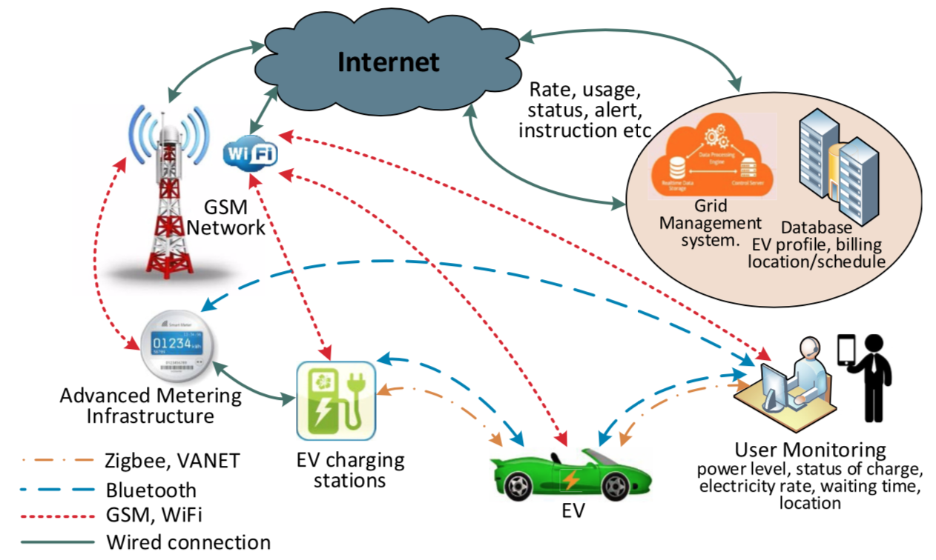
Communication network for EV charging
An effective communication system between EVs, EVSEs and the grid is necessary for a smart EV charging management
Available communication protocols can be classified into:
Wireline communication.
Wireless communication
Notes:
An effective communication system between EVs, EVSEs and the grid is necessary for a smart EV charging management
These technologies are applied for grid integration of EVs in different private networks, such as home area network (HAN), industrial area network (IAN), building area network (BAN), neighborhood area network (NAN) and field area network (FAN). These networks are used to control and monitor the EV charging/discharging and other domestic use of electricity as discussed below.
wireless communication
For complete communication struc ture, wireless communication is also required, such as for data exchange between the vehicles and the charging stations. It is the prime medium to provide the charging status information to EV users. The wireless communication network is constructed using Wireless LAN devices in a hierarchical mesh structure for interconnection of electrical devices. For EV grid connection, the popular wireless communication technologies include Zigbee, cellular, wifi, WiMAX and satellite networks.
The wireline technologies are suitable for long distance data transfer, such as the EV charging stations distributed in big cities. The most popular protocol in wireline communication technology is data communication over power line (PLC) which uses the same power line to send and receive information. The advantage of this protocol is its reliability and robustness to interference . Optical and Digital subscriber line (DSL) protocols can be found in the wireline communication system too. The optical communication protocol has extensively higher data rates (up to several Gbps), and the transmission range is significantly higher (several kilometers) than the PLC. Also, it is resilient against electromagnetic interference. Thus, using this technology, data transfer over a high voltage line is suitable [184,185]. DSL protocol enables digital communication over telephone lines, thus does not require separate infrastructure setup

Slide 10
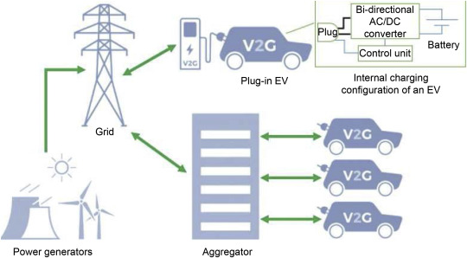
EV Integration in the Power Grid (EVGI)
Fully integrated systems that connect electric vehicles (EVs), transportation infrastructure, power grids, buildings, and renewable energy sources.
Minimal linkage between the transportation and electric power sectors only until recently. Disrupted the traditional business models of electric utilities
Primary : To charge the batteries of an EV
Secondary : to supply power back to the grid and provide ancillary services like harmonic mitigation, reactive power supply, peak power shaving and so on
Notes:
Large-scale electrification of transport has substantially disrupted the traditional business models of electric utilities and new challenges in the field

Slide 11
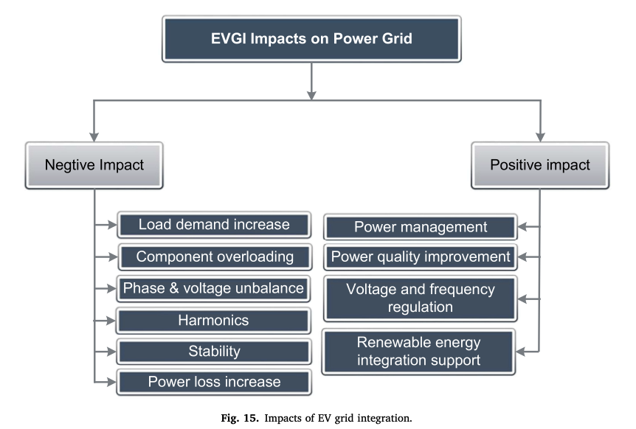
EV Integration in the Power Grid (EVGI)
Negative Impacts :
Excessive Integration can impact the load profile, voltage and frequency imbalances, excessive harmonic injection, power losses and the stability of the distribution grid
Positive Impact :
Power management, by scheduling charging and discharging cycles.
Power quality improvement : Solving voltage imbalances and flickers.
Renewable energy support : EVs as renewable energy buffer and storage
Notes:
Large-scale electrification of transport has substantially disrupted the traditional business models of electric utilities and new challenges in the field

Slide 12
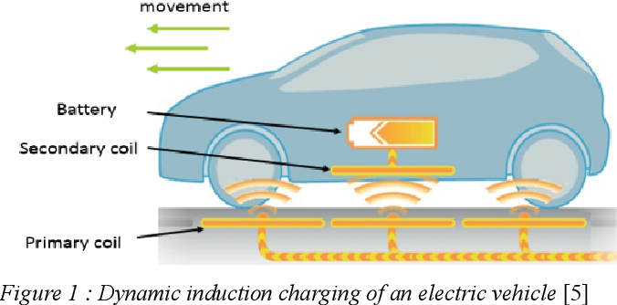
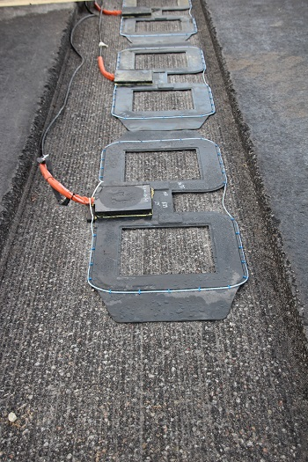
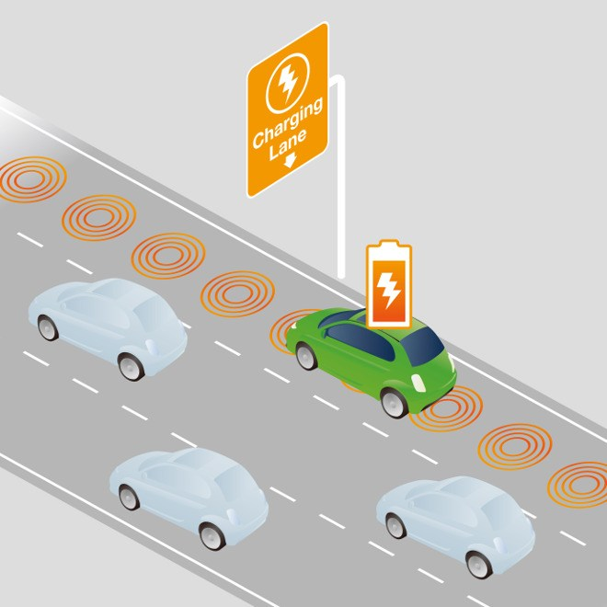
Future development trend of EVGI
Dynamic wireless power transfer
WPT transfers electrical energy through electromagnetics.
No physical Connection, less fault in charging equipment
charging equipment is protected from environmental hazards
next stage of WPT ? Dynamic WPT
Charging equipment installed under the road. higher no of EV charging simultaneously
ElectReon : initial tests on dynamic wireless charging of a 40-ton long-haul electric truck in Sweden. dynamic charging on 50m track at 30km/h, transferred 45kW to battery
http://techfinder.stanford.edu/technologies/S19-406_efficient-dynamic-wireless-power
Notes:
https://insights.globalspec.com/article/13768/dynamic-wireless-charging-success-in-long-haul-ev-truck-test

Slide 13
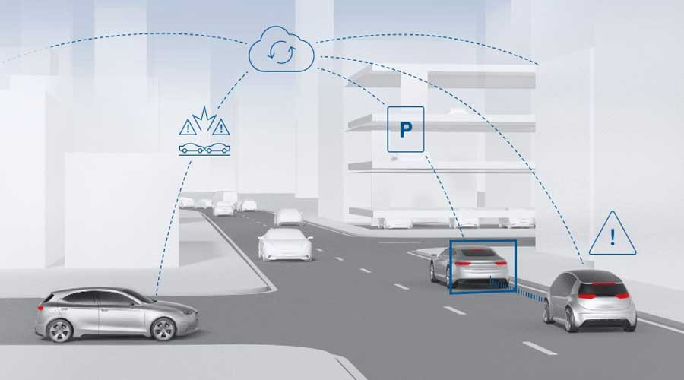
Connected Mobility (CM)
Communication between vehicle-to-vehicle, vehicle to a roadside base station, passenger, traffic signal, power grid, etc
The tech called Vehicle ad hoc network (VANET) interconnects vehicles, roadside base stations, and the communication channels.
Can be used to communicate between autonomous vehicles and Improve the driving experience, safety, and comfort, whilst reducing traffic congestion and holdups.
E.g : Decision Making on charging station 1 or station 2, scenarios
Notes:
If an EV is required to charge from a charging station (if dynamic WPT is not available), it can charge from different charging stations (station 1 or station 2). Station 1 is closer to the EV, but have higher charging price, also the traffic congestion is high on the road. However, charging station 2 has longer distance, but no traffic on the road and also charging price is lower ($0.15/kWh).

Slide 14
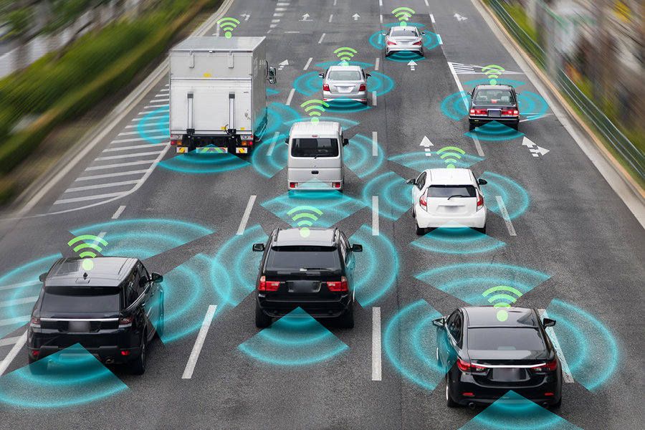
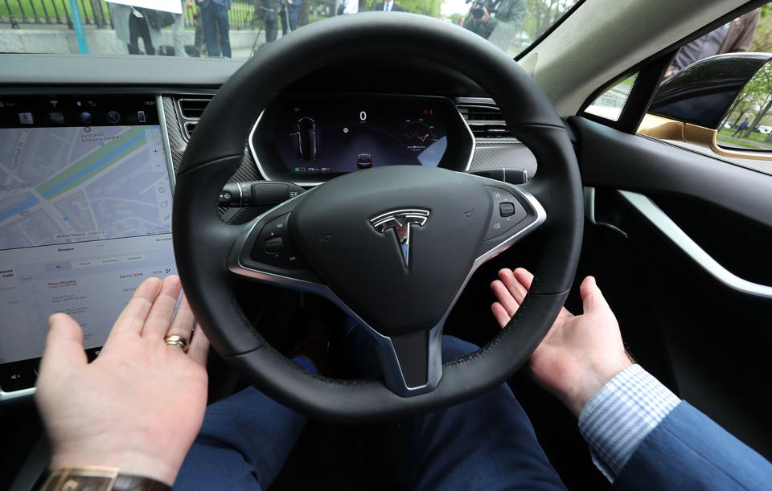
Autonomous electric vehicles
EV Shared Economy
Autonomous or self-driving vehicles, ability to sense their surroundings. driverless technology, where vehicle decides the travelling route, identifies road conditions, operates to reach the destination set by the user.
L0: no automated driving :L1 is driver assisted driving; L2 is semi-automated driving, L3 is highly automated driving, L5 is driverless phase; human just as passenger.
semi-automated driving phase (L2) achieved : adaptive cruise control, automatic lane keeping, etc. implemented in mass production. E.g Tesla
L5 car can itself park at best place and charge or discharge.
Using the collaborative consumption concept, people share EVs for their daily travel, and the vehicles are owned by a third party company such as Uber, Airbnb, google and so
Idle time for individual EV is high. Using Internet of things, big data facility, AI, and other tech, EV companies can optimize the EV operation, power grid and transportation
https://www.forbes.com/sites/jamesmorris/2021/03/13/why-is-teslas-full-self-driving-only-level-2-autonomous/?sh=2387ecdb6a32
Notes:
EV aggregator : flexible EV management business models. EV charging or discharging can be more effectively managed to avoid/reduce the peak load, provide load demand in special cases, participate grid frequency and voltage regulation, and use energy generated from renewable resources.
https://www.forbes.com/sites/jamesmorris/2021/03/13/why-is-teslas-full-self-driving-only-level-2-autonomous/?sh=2387ecdb6a32

Slide 15
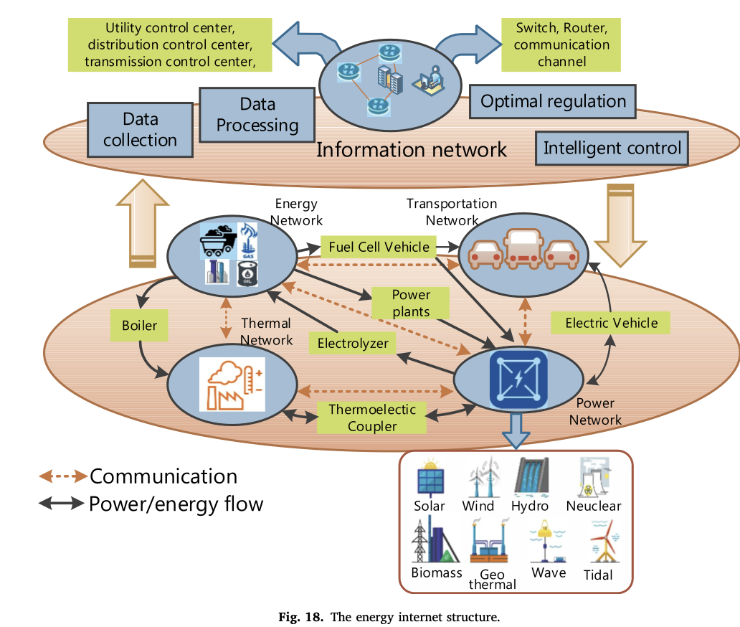
Energy Internet
The concept Aims to unify the power, transportation, gas, and thermal systems in a single platform. energy can be transformed for heating and cooling using boilers and chillers, or it can be transformed into electrical power
Vital element are EVs and FCEVs because they are connected to energy, power, and transportation network simultaneously.
Challenges of interoperability is the communication and control in the EI.
The information network collects data from each of the networks, processes and generates optimal operating criteria for each of the networks, and provides the intelligent control algorithm

Slide 16
Challenges and suggestions for EV charging
The standards for manufacturing charging equipment are not common globally.
All the public charging stations have charging facility for all power levels.
The establishment of private fast-charging facilities, such as at home, is still an issue, which normally requires EV owners to have permissions from the local utility providers and government.
Charging stations can start using renewable energy, such as PV or wind energy.
However, design and implementation are costly and require large space. Renewable energy based EV charging stations are best suitable in the highways where a lot of unused lands are available.
Notes:
Homogeneity in charging standards and devices can bring the cost down and make EVs more popular in the market.
not all the EV models support all levels of charging,
---
The establishment of private fast-charging facilities, such as at home, is still an issue, which normally requires EV owners to have permissions from the local utility providers and government. This lengthy process demotivates EV owners to set up private fast- charging facilities to meet their demands.

Slide 17
Challenges and suggestions for EVGI
In the modern grid, EVs work as electrical load, transportation media, energy storage, as well as communication nodes. They operate as a channel to interconnect the electricity grid, traffic network, and communication network. Design must include these factors.
Currently, the scheduling is mostly performed on off-peak charging. Introducing time-variable and charging power level, to resolve the grid-overloading problem.
wireless charging technologies are designed only for G2V operation.
With the advancement of the wireless charging, EVs should facilitate the bidirectional WPT to perform several ancillary services to the grid.
Well-developed business model can be beneficiary for EV owner, user, as well as utility companies.
Notes:
2) Coor

Slide 18
Conclusion & Proposal
With the advancement of EV technology, charging infrastructure and grid integration facilities, EV popularity is expected to increase.
Energy Internet could be a future grid technology, which will make the power system fully automated with advanced energy management systems.
Unified standards for EVs and its charging infrastructure all over the world is a primary necessity for EVs to gain popularity in the market
Future Scope
Research on current data w.r.t EV technology and future predictions
Study and comparison of the different EV features and how it impacts the power ecosystem.
Study of feature optimisation algorithms for Peak load minimization, Charging cost minimization and Model Predictive control to gauge the efficient operation of a grid-connected EV charging station.

Slide 19
Thank You

Slide 20
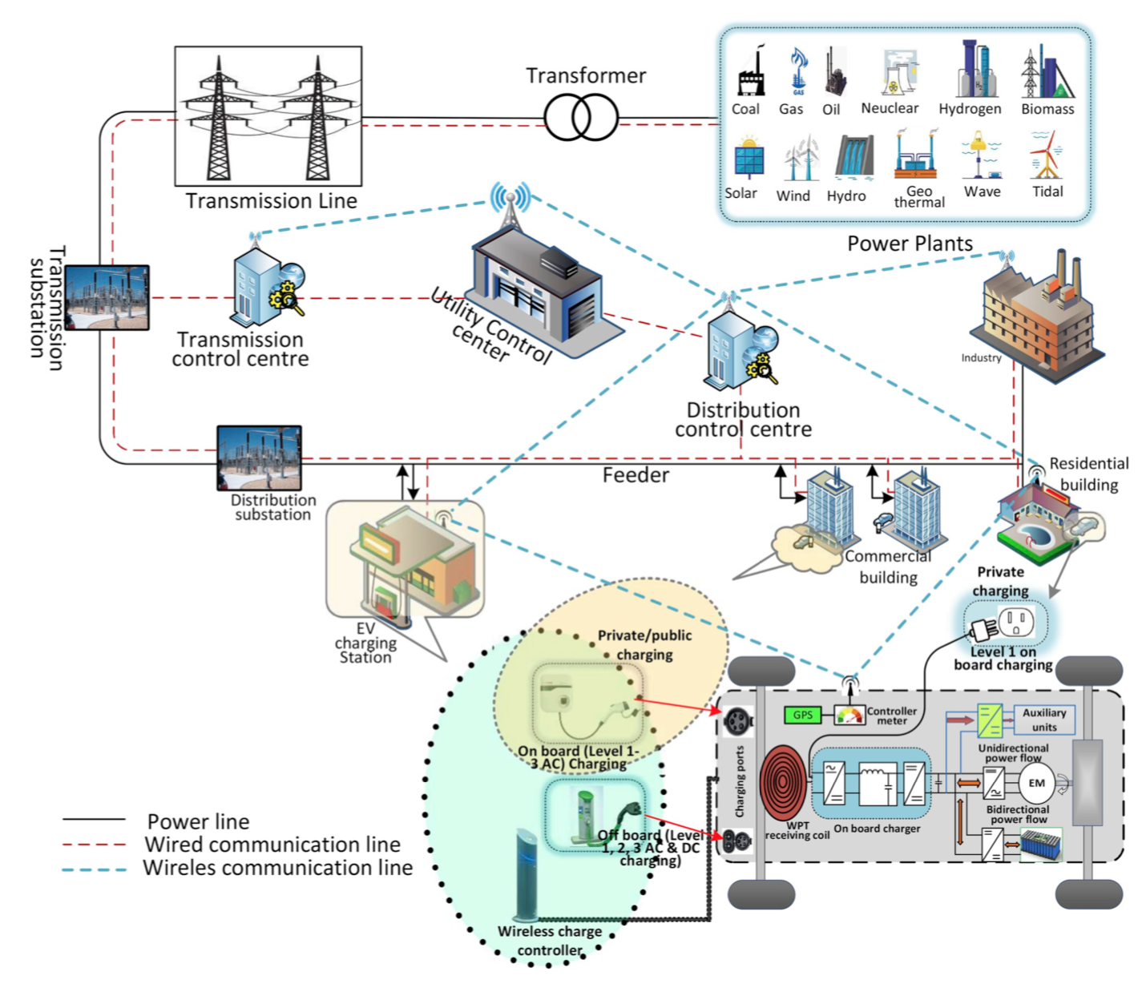

Slide 21
Introduction
The increasing popularity of EVs results in higher number of charging stations, which have significant effects on the electricity grid.
Grid integration methods, are being developed to minimize the adverse effects of EV charging and to strengthen the benefits of EV grid integration
To make EVs competitive in the market, a number of challenges need to resolve, such as battery cost, efficient charging strategies, interoperability of the charging stations, and the impact of EV integration to the grid.
Moreover, successful growth of EVs over the next decade relies on the development of international standards and codes
Impact of EV charging on the grid is important for the expansion of the EV market
Notes:
The conventional transportation system that incorporates an internal combustion engine (ICE) is the major contributor to air pollution [1]. To reduce air pollution and oil dependence in the transportation sector, there has been an increased overall market adoption of electric vehicles (EVs) in recent years. EVs use batteries, ultracapacitors, and fuel cells as energy sources, which have no dependency on fossil fuel and no polluted gas emission.

Slide 22





Standards : EV charging and grid integration
There are several standards available worldwide which deal with EV charging and grid infrastructure. SAE and IEEE are used in U.S.A. based manufacturers whereas IEC (International Electrotechnical commission) is vastly used in Europe. Japan has their own EV charging standards named CHAdeMO. China uses Guobiao (GB/T) standard (issued by the Standardization Administration of China and Chinese National Committee of ISO and IEC) for AC and DC charging, where GB/T AC charging standards are similar to IEC standards
Standardization related to EV charging can be segregated into three areas: EV charging component standards, EVGI standards, and safety standards.
Notes:
The evolution of EVs has created new dimensions in transportation and electric power industry. To operate this new technology uniformly all over the globe, it is essential to standardize every aspect of it.
During charging/discharging from the grid, EVs act like a distributed energy resource (DER). Thus, the grid interconnection standards of DERs also apply on EVGI.
Different countries follow different charging standards
The major difference among these charging standards lies in the ports/connectors design. Manufacturers are trying to come up with a common charging connector to avoid charging standard conflicts.
In US, SAE standard connectors can be used for both AC and DC charging. Tesla has designed its own connector which can perform fast AC and DC charging.Tesla has also made connectors which acts as a convertor from SAE standard connectors can be used in Tesla charging stations. Charging connector like “combo” which is widely used in Europe. It adds separate DC pins to the existing ac charging connectors. All the connectors and ports are quite different from each other.

Slide 23
EV aggregator
EV aggregator groups the EVs according to EV owners’ choice to realize business opportunities in the electricity market.
`Individual EV’s contribution to the market would be insignificant and unreliable, which can be improved by grouping the EVs and operating through EV aggregators.
Interface between the grid and EVs; send the info of EV drivers (charging power demand, connection time via the smart meter) to the grid operators.
electricity price and in- formation of charging station locations which are delivered to the EV owners.
Check Demand prices from DSO.

Slide 24
Dynamic wireless power transfer
In US, Wind and Solar power plants are built along the highways, in which the dynamic WPT technology can be integrated with renewable energy technology.
Electric energy : charging EVs -> from wind turbines (during the night) and solar photovoltaic arrays (during the day) on both sides of roads.
Power from main grid -> as a reserve
Electrical energy right close to source. Reduced transmission of network congestion, reduce power transmission losses, improve the utilization rate of renewable energies
Bidirectional power flow facility
EVs can discharge power wirelessly to the grid when the grid load demand is high. It can be done in EV charging stations using static WPT or if the dynamic WPT has bidirectional power flow facility

Slide 25
Smart charging algorithms The EV charging models need to be more comprehensive in nature, i.e., multiple charging powers, charging station and battery-swapping station, and wholesale market trading and ancillary services provisions, in order to more accurately and realistically model the practical implementation. More studies with respect to finding the optimal trade-offs between computational burden and performance should be made

Slide 26
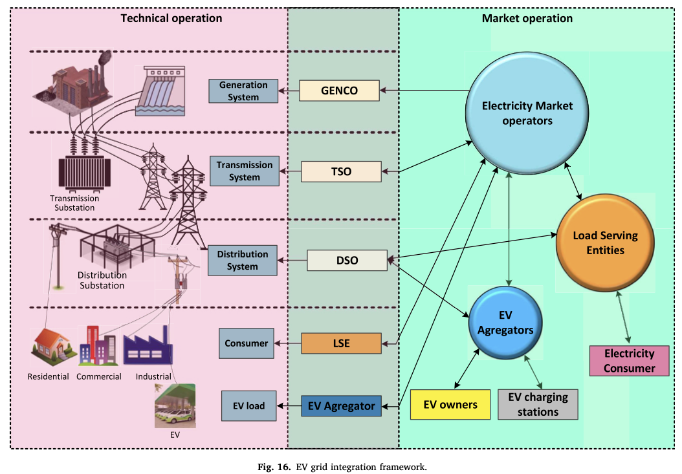

Slide 27
Discussion on future EVGI development trend
Autonomous EVs are now in L2 development phase, which can be accelerated to reach L5. Fully autonomous EVs can offer a lot to transportation network as well as power grid through EVGI.
Energy internet is the future grid structure, where EVs can play a key role by unifying the power, transportation, energy, as well as communication network. A plenty of development in each sector is required to develop a fully functioning energy internet.
Notes:
2) If the capacity of VANET can be expanded to integrate power grid, traffic network, EVs and users, it can help to move forward for better EVGI experience.

